Slide 1
ownCloud Community Edition – Version 7
John Smith
Notes:
Subject of the talk is: taking back your data with ownCloud 7
Depending on your audience, you can choose to remove the developer section.
If you want to make sure you fill your time slot (if you have, for example, 30 minutes to talk and you are worried you don't have enough to fill the time) just add some more screen shots at the end! You can tell people they can ask questions while you go over the screenshots.

Slide 2

About Me
John Smith, Community Enthusiast by night; candy maker by day
owncloud.org
<number>
Notes:
(about yourself – modify the slide...)

Slide 3
Why privacy?
Notes:
Privacy, owning your data, is more important than most people realize. Your data is easy to abuse by governments, companies and individuals, costing you money at best and your freedom at worst.
ownCloud offers a solution.

Slide 4
About ownCloud
File sync and share
Open Source
Easy to use
Easy to install
Easy to extend
owncloud.org
<number>
Notes:
ownCloud is a server app which offers a file synchronization and file share solution.
It is open source, has an easy to use web interface and apps for mobile devices.
It is written in PHP so it is easy to install and it supports apps so you can add all kinds of functionality.

Slide 5
Agenda
For end users
Sharing, overview and ease of use
For administrators
More control
For developers
Faster and deeper integration
Notes:
Will talk about the new features for users, administrators and developers.

Slide 6
ownCloud 7 -- For end users
Notes:
For ownCloud, user experience is super important. Our goal is to eliminate as many barriers as possible which block people from owning their own data. ownCloud 7 makes progress with that by:
making sharing easier
giving a better overview of who owns what and by
improving the ownCloud user interface.

Slide 7
Sharing
Notes:
Sharing
Advantage of public cloud over private cloud: easy to connect to others on same cloud.
With ownCloud, you could share an anonymous link or add an account for somebody on your cloud
Server to Server sharing brings clouds together in a easier way. Just add a share from somebody to your ownCloud and the files are added like they belong there. Syncing with the client and moving them around all works cleanly.
ownCloud 7 makes sharing not just easier but also more flexible. Like other file share clouds, ownCloud 6 had a 'shared' folder where it put files shared with you. In ownCloud 7 you can put those files wherever you want – you don't even have to have a 'shared' folder at all anymore.

Slide 8
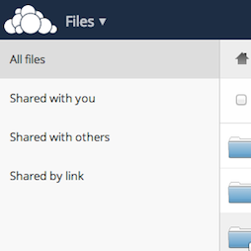
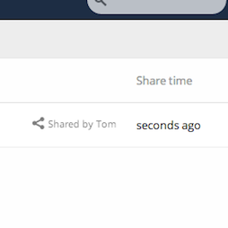
Sharing Overview
Notes:
Overview
Of course, that means you need another way to know what files are yours and which are not.
OwnCloud 7 shows the owner of files and the sharing state in the Files app. It also offers a sidebar where you can see all files you have shared with others or that others have shared with you!

Slide 9
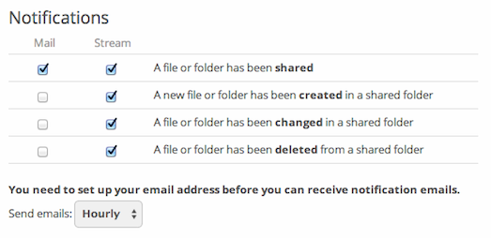
Notifications
Notes:
To make it even easier to follow what is going on with your files, the improved Notification app allows you to receive emails when certain things happen, like when somebody has shared a document with you.

Slide 10
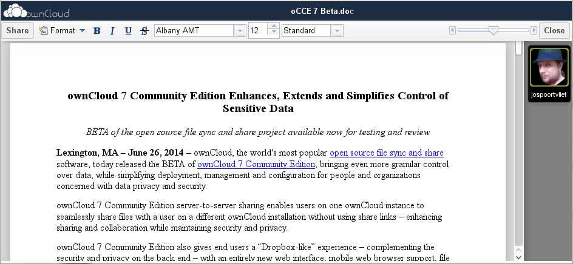
Documents
Notes:
ownCloud 6 introduced collaborative document editing and we have now added one important feature to that: ownCloud can automatically convert Microsoft Word documents to ODF and back after editing.

Slide 11
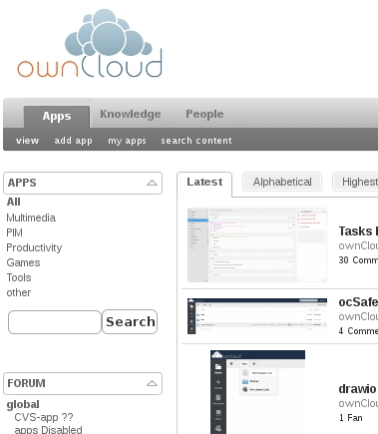
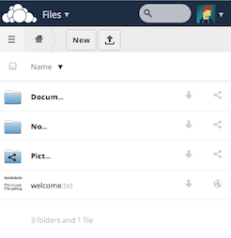
More
Notes:
There is more
There have been more improvements. We've introduced a mobile interface, performance and user interface improvements all over and the ownCloud apps bundled with ownCloud 7 are more awesome than ever.
On apps.ownCloud.com is already a bunch of updated ownCloud 7 apps, including a much improved new Tasks app and Passman, a password manager.

Slide 12
ownCloud 7 --For administrators
Notes:
Administrators
The key for ownCloud is control over your data, so it should not be a big surprise that ownCloud 7 introduces more finegrained control over the ownCloud server.

Slide 13
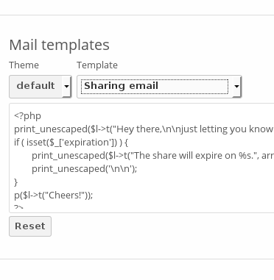
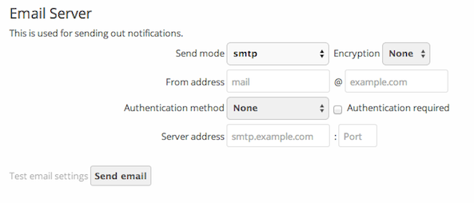
Email
Notes:
Editable email templates and configuration
ownCloud 7 introduces an easy way to edit the templates of emails send by ownCloud 7 for password recovery and sending shared files and links. New is also a graphical interface for easily configuring SMTP.

Slide 14
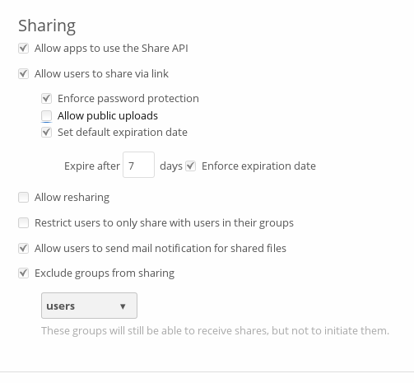
Control Sharing
Notes:
Control over sharing
ownCloud administrators can now force users to set a password shen they create shared links. They can also set a default Maximum Expiration time on links and enforce it if they want to. Last but not least, sharing can be enabled or disabled depending on group membership.

Slide 15
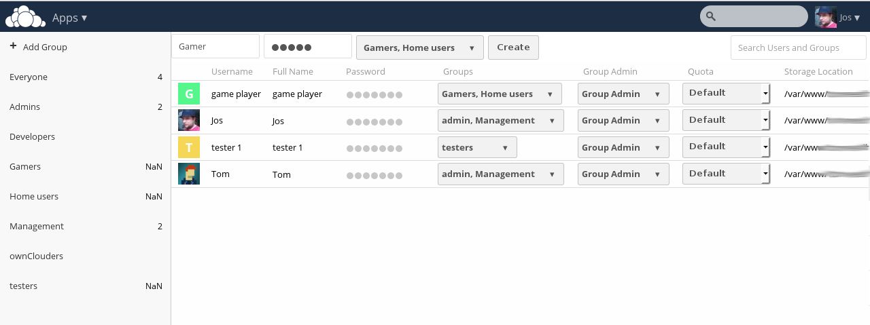
User management
Notes:
User management
There have been many improvements to user management. Not only does the management interface provide more information like storage location, last login time and more in a single, scrolling list, it is easier to find users thanks to the filtering by group or by an arbitrary text. Installations using LDAP will benefit from much improved performance.

Slide 16
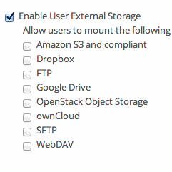
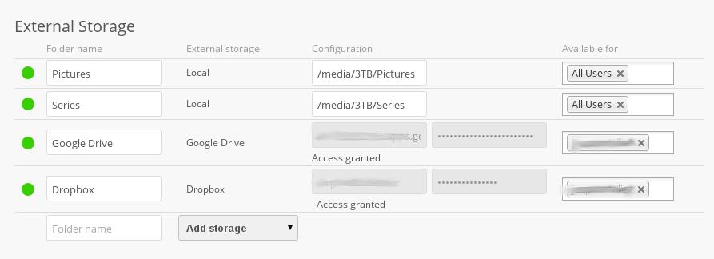
Storage
Notes:
Object storage, external storage
ownCloud can now use object storage like Swift as primary storage. Admins can also decide if and what types of external storage users can add and how it counts against their storage limit calculation.

Slide 17
ownCloud 7 -- For developers
Notes:
For developers
ownCloud 7 also brings new features to developers. There are three kinds of developers who will enjoy what is new in ownCloud 7: ownCloud App developers, developers of third-party applications connecting to ownCloud and of course everybody who wants to improve ownCloud itself.

Slide 18
App developers
Database layer
Interface for controller classes
CORS implementation
Updated documentation
Notes:
App developers
If you want to develop an ownCloud app, you will appreciate the improvements to the app framework. The introduction of a simple database layer makes it easier to store and retrieve data and the improved interface for creating controler classes saves you time as well. Advanced database work will benefit from the support for sockets. We also introduced an easy CORS implementation for cross-domain communication and have updated the development documentation.

Slide 19
Third party developers
Pub/sub model Webhooks
API for sharing status
Notes:
Third Party developers
It is now easier to integrate ownCloud into your application. We have developed Webhooks which offer a publication/subscription model. Also new is an API to provide apps with information on the sharing state of files so they can provide their users with a visual representation of who owns the data and if it is shared or not. This is used by the ownCloud client to show with overlay icons in file managers if files are shared, if they are being synced and so on (client version 1.7+ only).

Slide 20
The END!
Sharing
Server2server
Overview
Control
Control
Notifications
User management
Email
Easier app development
Notes:
That's it!
This was an overview of what is new in ownCloud 7. I know, it was a LOT. Let me summarize:
more sharing: server2server, clear view of what is shared, admin can control who shares what and how. And no more shared folder: put the files wherever you want!
Improved control: notifications, user management, email templates and configuration and more
Easier and faster development of ownCloud apps and integration in third party apps.

Slide 21
OwnCloud -- Questions?
Notes:
If you want to make sure you fill your time slot (if you have, for example, 30 minutes to talk and you are worried you don't have enough to fill the time) just add some more screen shots at the end! You can tell people they can ask questions while you go over the screenshots.

